Slide 1

Project Presentation of Back End Engineering Project (BEE) (22CS026)
On
Eco-Conscious
Submitted by: Jashanjit Kaur (2210990440)
Jasjeet Kaur (2210990442)
Kamaljeet Kaur (2210990470)
Kanchan Yadav (2210990471)
Kashika (2210990493)
Supervised By:
Mr. Shiv Mohan
Department of Computer Science and Engineering,
Chitkara University, Punjab

Slide 2
Table of Contents
Introduction
Software Requirement
Hardware Requirement
Feasibility Study
Techniques Used
Flowchart
Results
Conclusion
References/Links used
Q&A

Slide 3


Introduction
Our project idea is to create an eco-friendly e-commerce platform that promotes sustainable products.
The platform not only allows users to shop for eco-friendly items but also suggests alternative products based on specific environmental criteria, helping consumers make more informed, sustainable choices.

Slide 4
Software Requirements
1. GitHub: For version control and collaborative development.
2. VS Code: Code editor for writing and managing the project code.
3. MERN Stack: Framework stack (MongoDB, Express.js, React.js, Node.js) for building the full-stack application.
4. MongoDB Atlas: Cloud-based service for hosting the MongoDB database.

Slide 5
Hardware Requirements
1. Client Laptop/Computer: A device capable of running a modern web browser for accessing the application.
2. High-Speed Internet Connection: Ensures smooth and fast interaction with the server and application.

Slide 6
Feasibility Study
Technical Feasibility:
Leveraging the MERN stack ensures compatibility and scalability.
Existing libraries and frameworks reduce development complexity.
Economic Feasibility:
Minimal cost due to the use of open-source technologies (Node.js, MongoDB, React).
Revenue potential through commissions on eco-friendly products.
Operational Feasibility:
Easy-to-use interface encourages user adoption.
Meets the demand for sustainable shopping.
Schedule Feasibility:
Development plan was divided into sprints

Slide 7
Techniques Used
Authentication:
JWT-based secure login and logout for user accounts.
Database Design:
Collections for users, products, wishlist, cart, and orders.
Fields like EcoScore, environment criteria (carbonFootprint , recyclability) .
Recommendation Algorithm:
Suggests alternative products with higher eco-scores based on user searches.
Frontend Design:
React components for dynamic product browsing.
Backend Development:
Express.js for seamless API routing and CRUD operations.
Environmental Scoring:
Weighted algorithm to calculate EcoScore based on environmental criteria.

Slide 8
Key Features
1. Sign up, Login, Logout (JWT) : secure and seamless access with JWT-based authentication for a personalized shopping experience. Further email verification is also added for more security.
2. Eco-Score: Each product’s eco-score highlights its environment impact, helping users shop responsibly.
3. Categories & Search: Effortlessly browse or search for products across eco-friendly categories to find exactly wat you need.
4. Filtering by environment Criteria: Filter products by various factors like carbon footprints, recyclability etc.
5. Sorting by price: Easily sort products by price within each category to find the eco-friendly options that fit your budget.

Slide 9
Key Features
6. Product Profile: Detailed product page showcasing sustainability data, including eco-score and environment metrices.
7. Alternative Products: Discover greener alternative with better eco-scores, making sustainable shopping easier than ever.
8. Wishlist & Cart: Add your favorite items in the Wishlist or move them directly in your cart.
9. Buy now and Order history: Buy products, and track your previous orders.
10. User Profile, Edit details, Delete profile: Easily update your profile details or delete your account if needed.

Slide 10
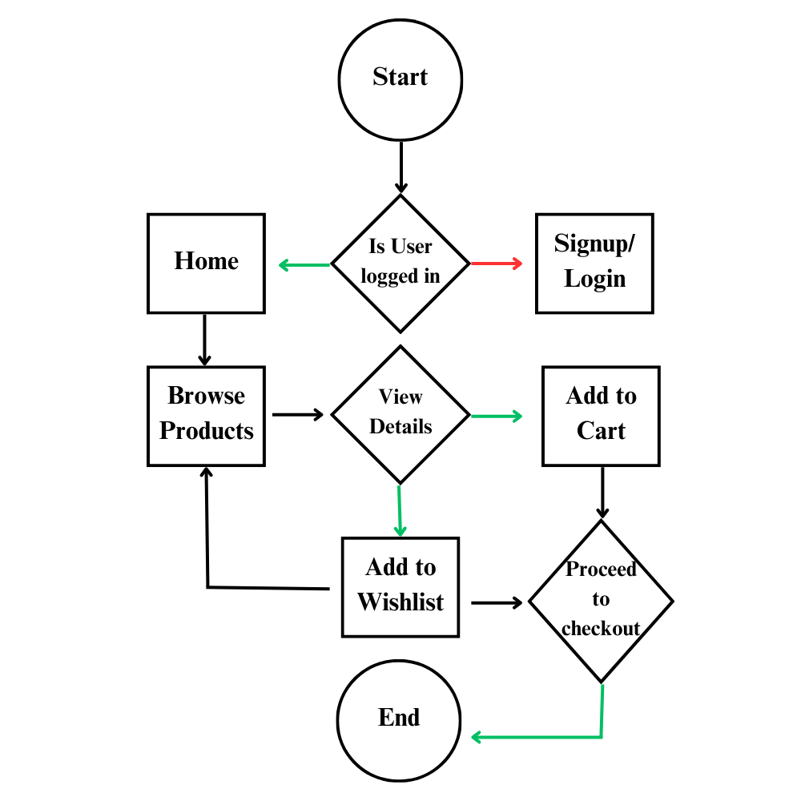
Flowchart

Slide 11
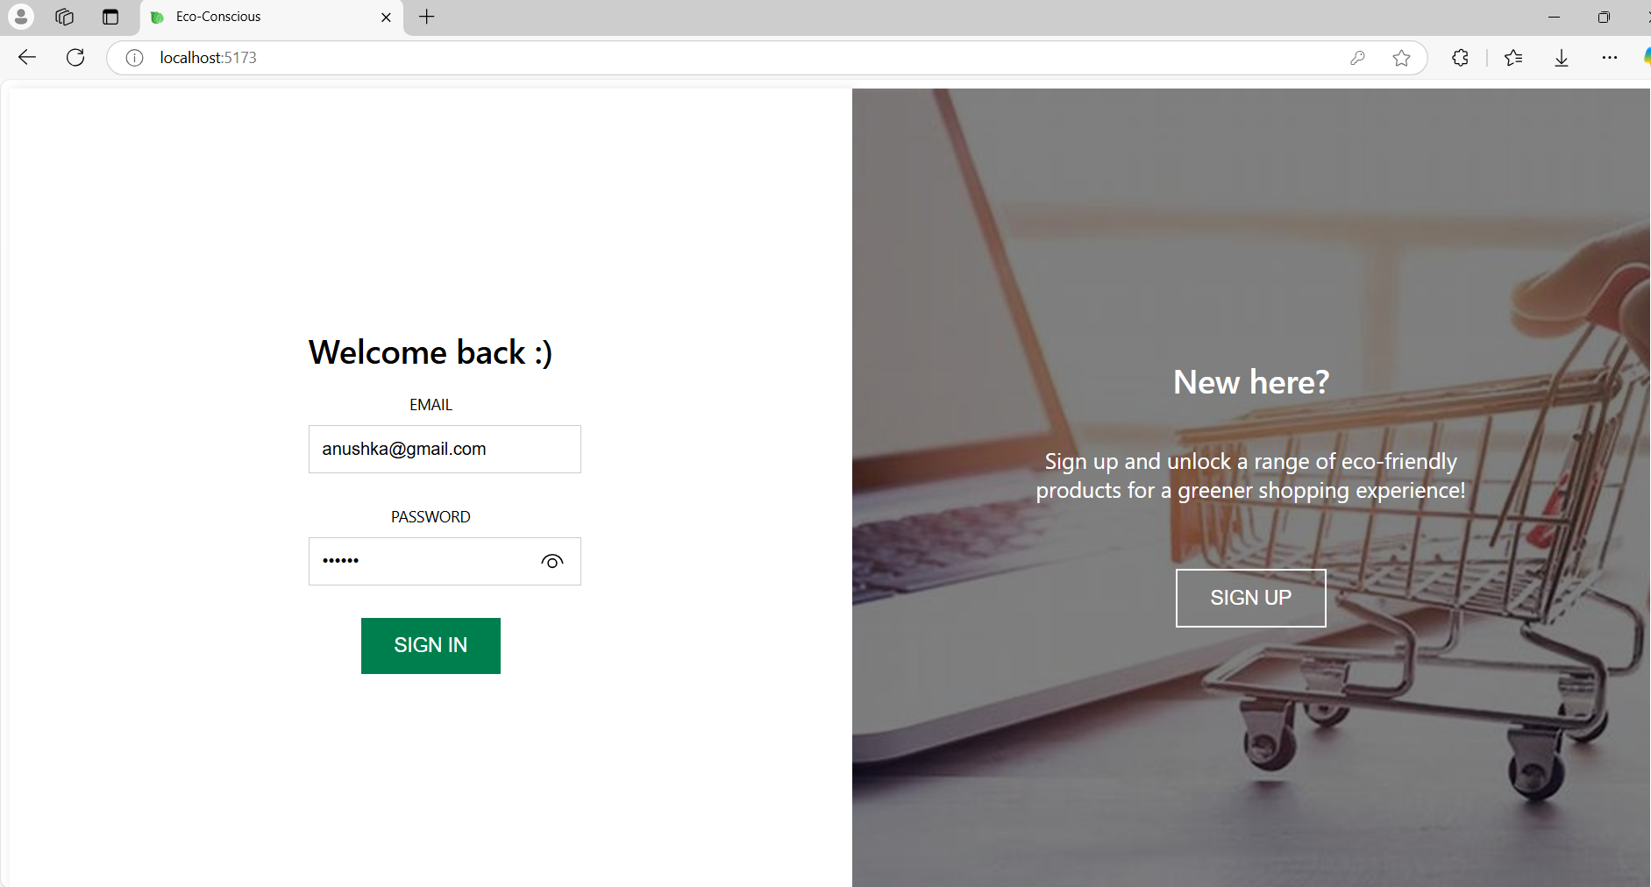
Project Highlights
Signup & Login

Slide 12
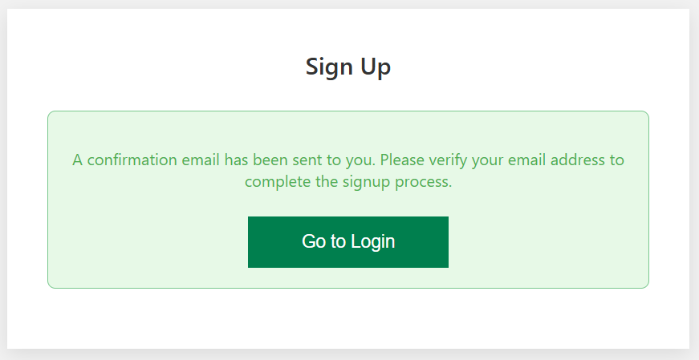
Project Highlights
Email - verification

Slide 13
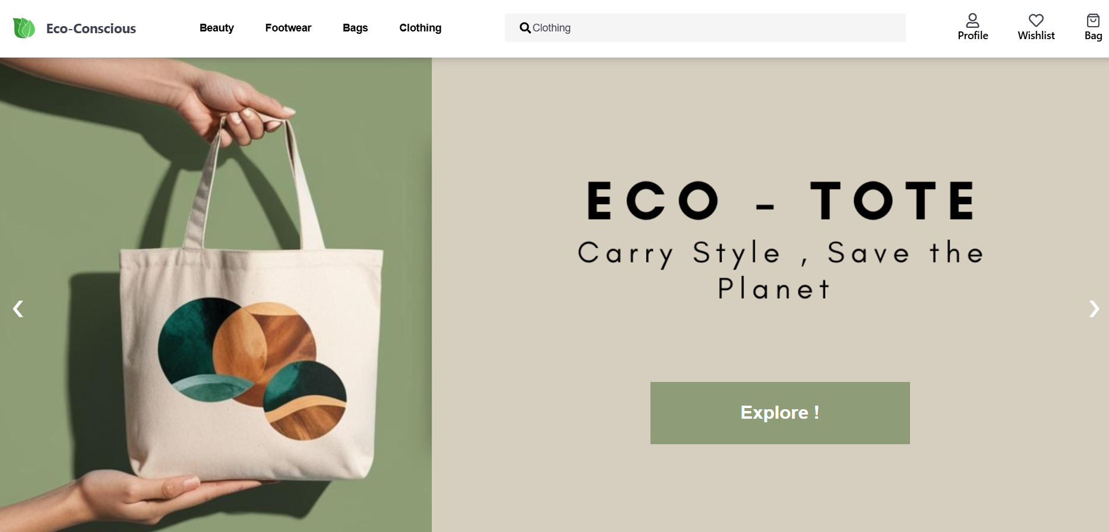
Project Highlights
Home

Slide 14

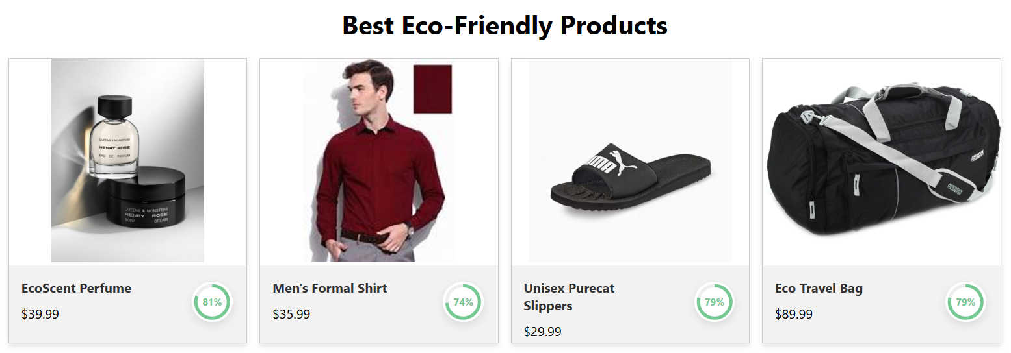
Project Highlights

Slide 15
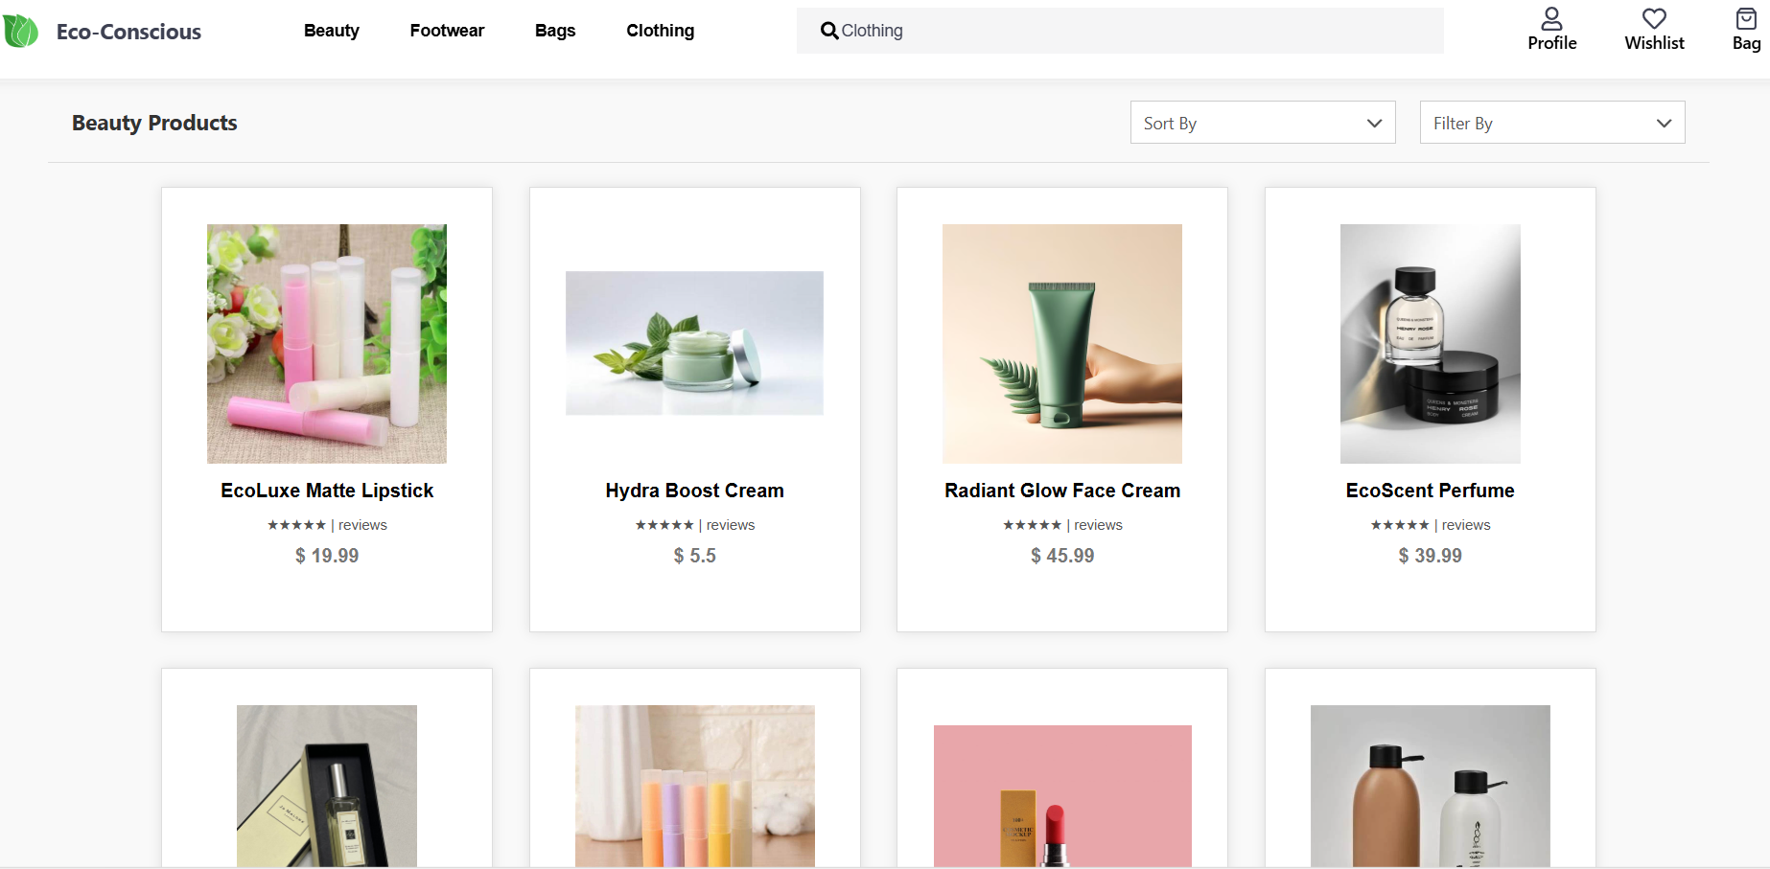
Project Highlights
Category

Slide 16
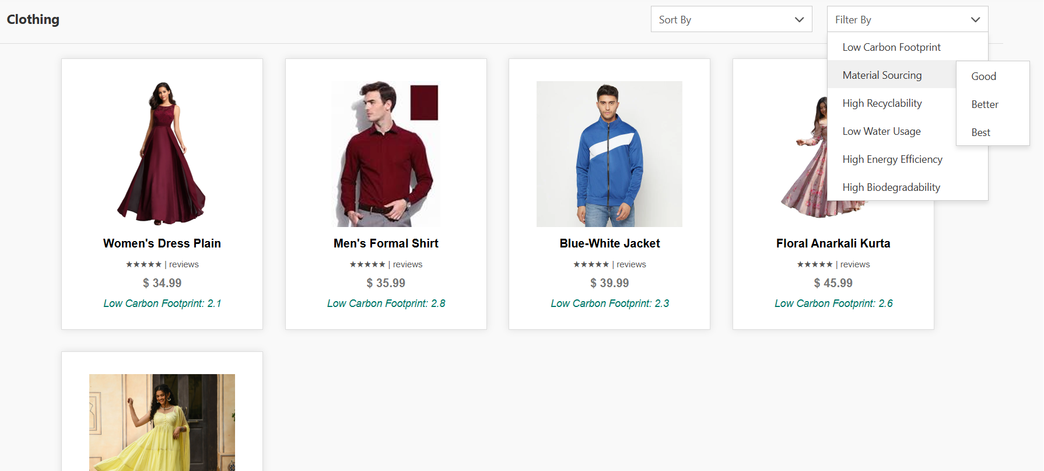
Project Highlights
Filters

Slide 17
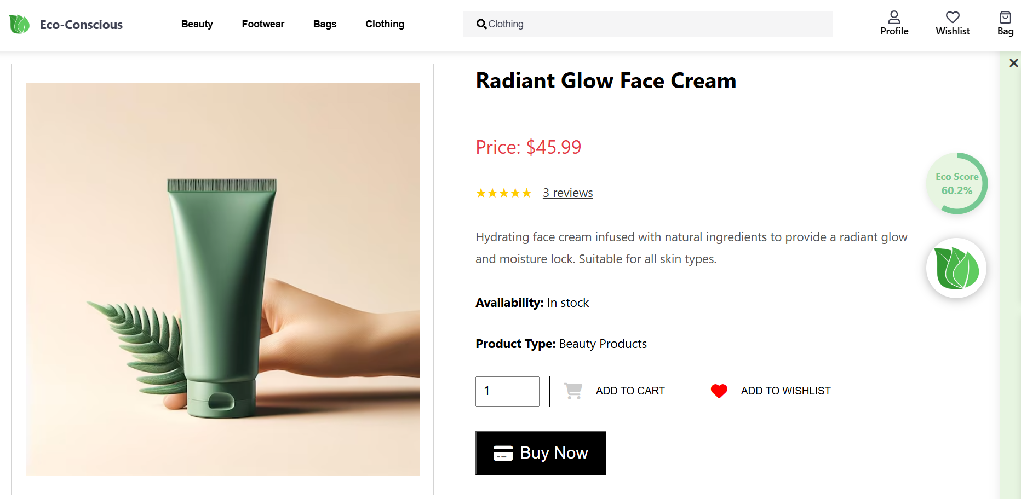
Project Highlights
Product Profile

Slide 18
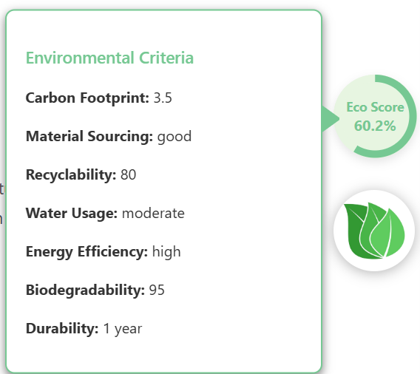

Project Highlights
Environmental Impact

Slide 19
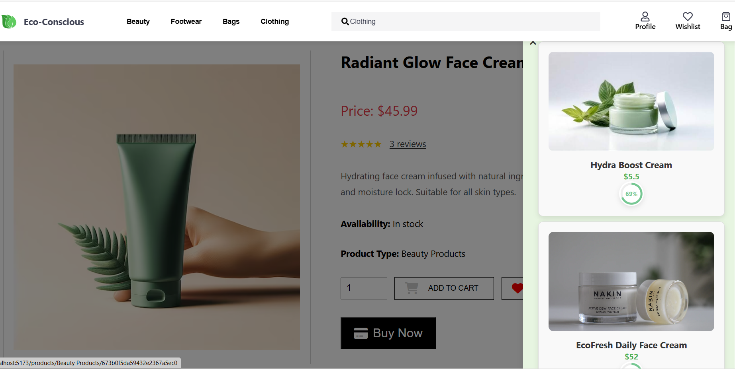
Project Highlights
Alternatives

Slide 20
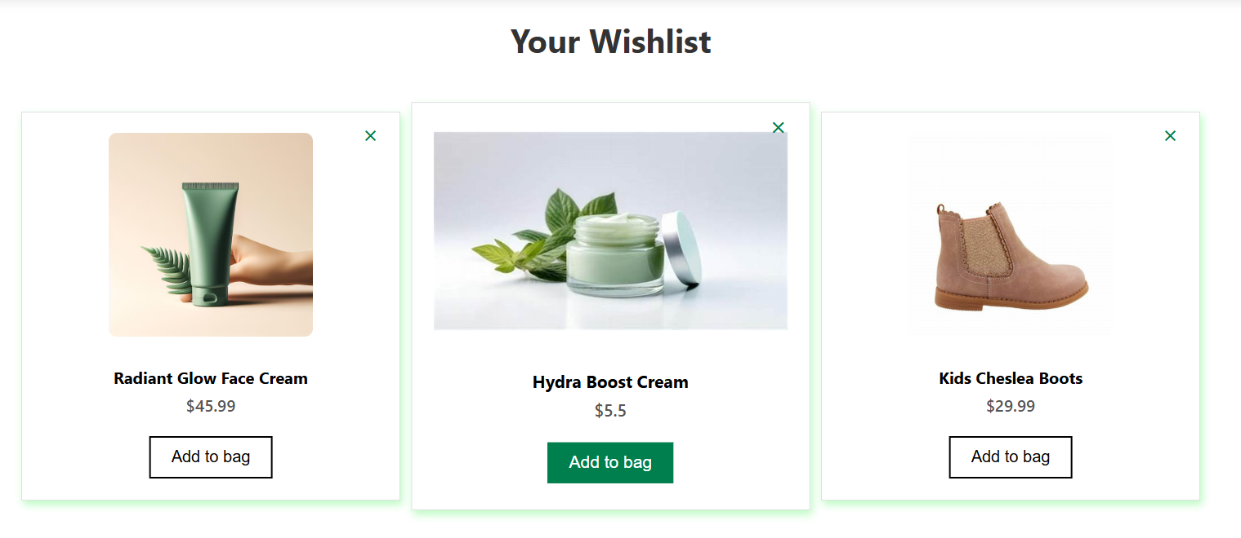
Project Highlights
Wishlist

Slide 21
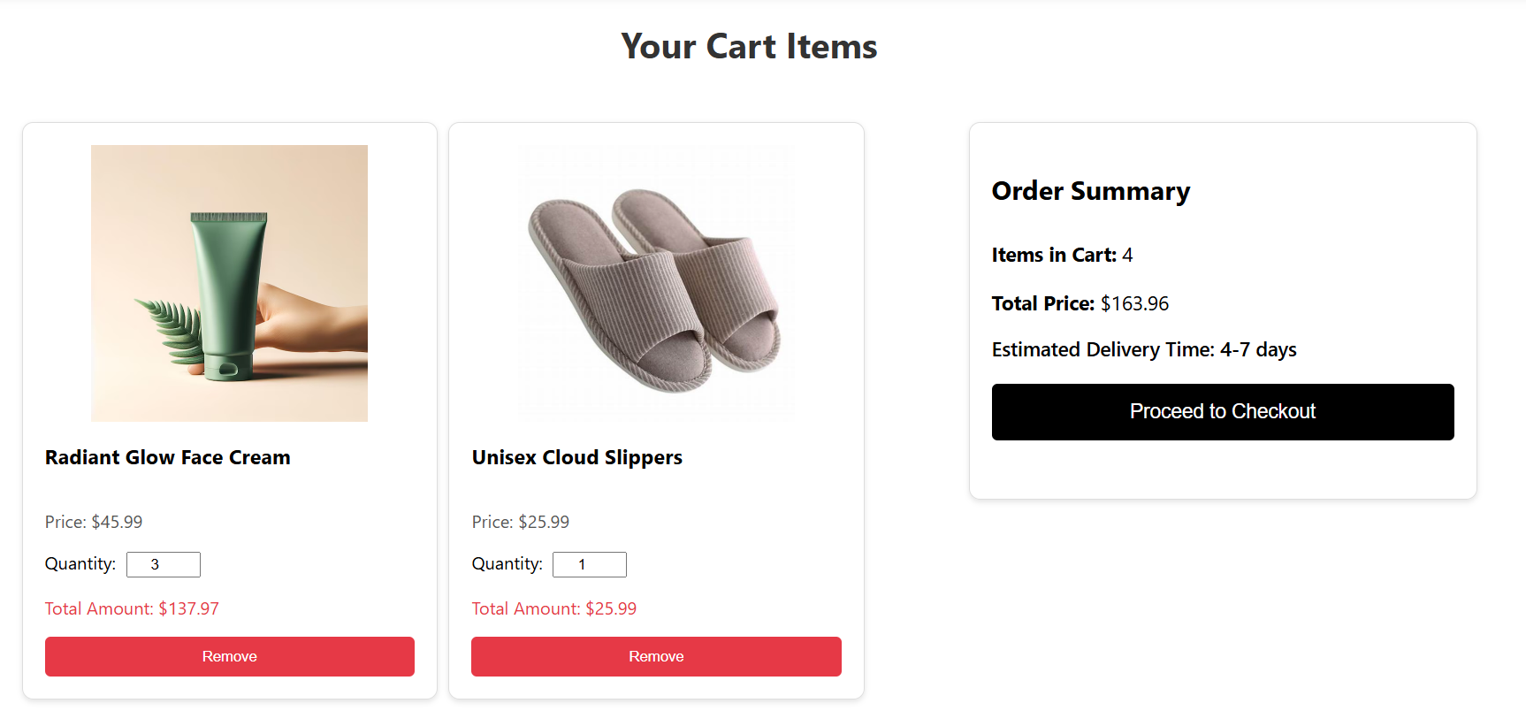
Project Highlights
Cart

Slide 22
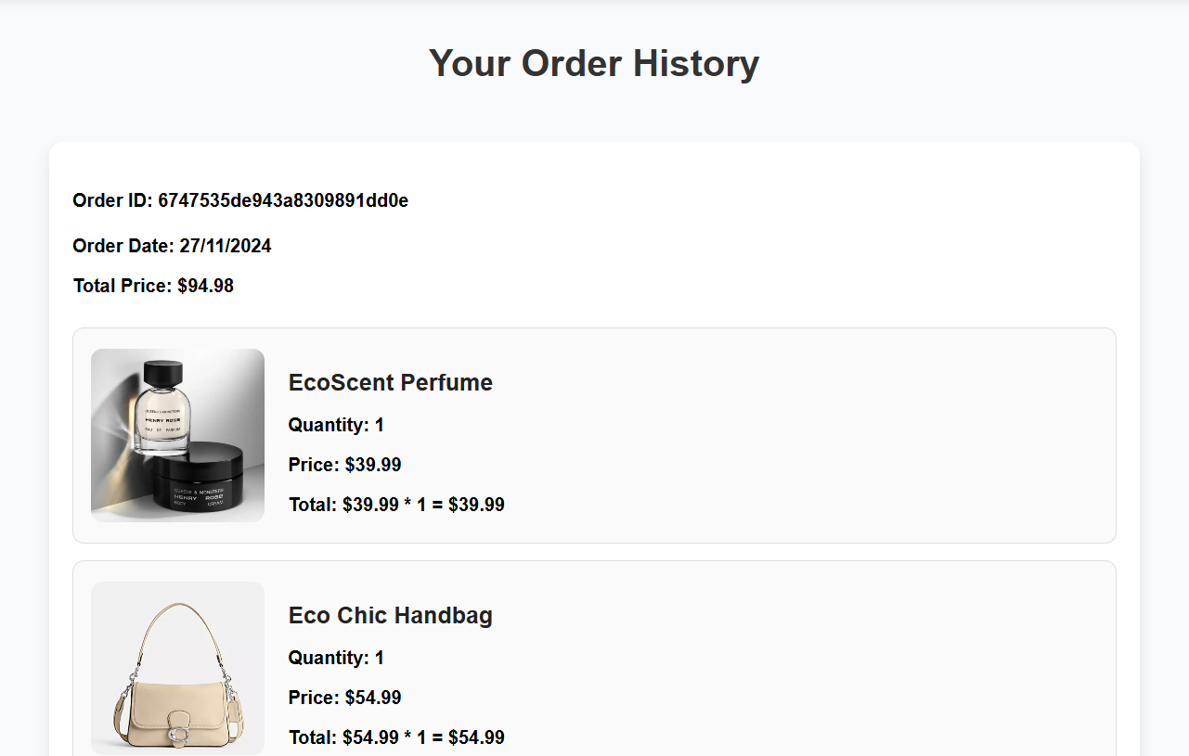
Project Highlights
Orders

Slide 23
Results
User Authentication:
We implemented a secure and hassle-free login and logout system to ensure a smooth user experience.
Product Management:
Our platform focuses on displaying eco-friendly products, each rated with eco-scores and aligned with environmental criteria to promote sustainability.
Recommendations:
We provide users with suggestions for alternative products that have better eco-scores, helping them make more sustainable choices.
Shopping Experience
Users can filter by price, categories, and sustainability criteria.
Order Management:
Tracks purchase history, cart management, and wishlist features.

Slide 24
Conclusion
Our eco-friendly e-commerce platform is designed to empower consumers to make sustainable shopping choices effortlessly. By integrating advanced features like product eco-scoring, environmental filters, and alternative suggestions, we aim to bridge the gap between conscious consumerism and convenience.
The project leverages modern technologies such as MongoDB, Express, React, and Node.js to create a robust, user-friendly experience that promotes sustainability at every step. As we continue to enhance the platform, our mission remains clear:
“Redefining shopping with purpose for a sustainable tomorrow ☺ ”

Slide 25
Repository Link
https://github.com/ydv-kanchan/Eco-Conscious
Contributing We welcome contributions from everyone! If you're interested in contributing:
Fork the repo
Create a new branch
Commit your changes
Push and create a pull request

Slide 26
References/Links used
https://expressjs.com/
https://nodejs.org/en
https://www.mongodb.com/
https://react.dev/

Slide 27


Slide 28


